Slide 1
Programming Concepts

Slide 2
High Level Agenda
Introduction to core Programming concepts
Programming Language concepts
Object Oriented Programming Concepts
Angular
Introduction to Automation Testing
Automated Testing Process

Slide 3

Introduction to Core Programming Concepts ​
  Variables ​
  Control Structures ​
  Data Structures
  ​

Slide 4
Simple Data Types
Boolean Type – Only true of false
Integral types – sbyte, byte,short,ushort,int,uint,long,ulong,char
Floating type – float and double
Decimal types

Slide 5
Boolean
Bool b = true;
  b = 123; //error
  b = false; //correct

Slide 6
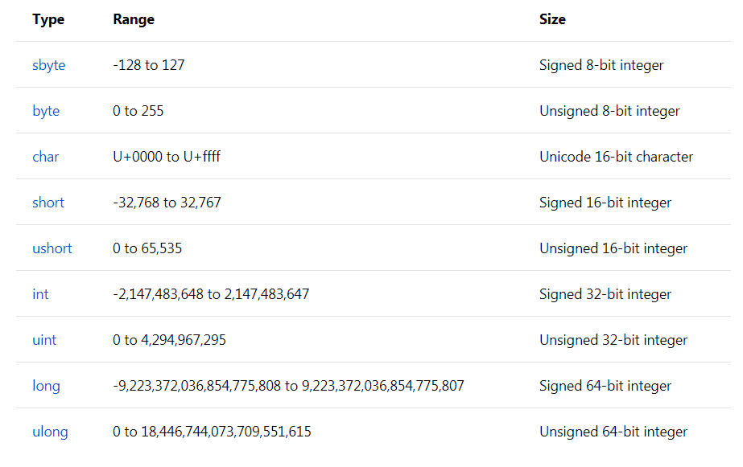
Integer data type

Slide 7
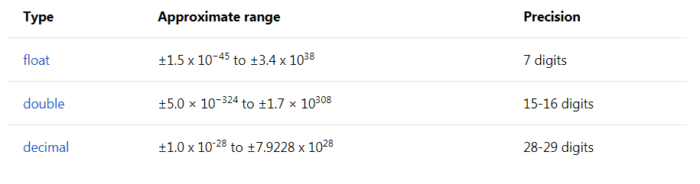
Floating data types

Slide 8
Common Operators
    Assignment Operator =
    Arithmetic Operators like + , - , *, /, %
    Comparison Operators like ==, !=, >, >=, <, <=
    Conditional Operators like &&, ||
    Null Coalescing Operator ??

Slide 9
Nullable types
By Default value types are non nullable. To make them nullable use ?
Int i = 0 ; correct
Int i = null; incorrect
int? i = null; correct
String name = null ; correct
String name = “Sanjay”; correct

Slide 10
Compatibility and Conversion
Conversion are two types
Implicit conversion
Explicit conversion
Implicit conversion is done by the compiler:
1. When there is no loss of information if the conversion is done
2. If there is no possibility of throwing exceptions during the conversion
Example : Converting an int to a float will not loose any data and no exception will be thrown, hence an implicit conversion can be done.
Where as when converting a float to an int, we loose the fractional part and also a possibility of overflow exception. Hence, in this case an explicit conversion is required. For explicit conversion we can use cast operator or the convert class.

Slide 11
Control Structures
In a program, a control structure determines the order in which statements are executed.
The following are the basic control structures in the programming languages:
  Sequential/Iteration :
    In Sequential execution each statement in the source code will be executed one by one in a sequential order. This is the default mode of execution.
  Selection/Conditional :
    The selection control structure is used for making decisions and branching statements, the following are the basic selection statements in the programming language.

Slide 12
Selection/Conditional
If Statement:
The If statement checks for the condition and if the condition is satisfied it executes the statements in the “if” block, otherwise it exits the “if” block.
Syntax:
  If(condition)
  {
    Statements;
  }
if-else:
If-else statement is used to execute any of the two blocks of statements, if the condition satisfies it executes the statements in the “if block”, otherwise it executes the “else block”.
Syntax:
    If(Condition)
    {
      Statements:
    }
    Else
    {
      Statements:
    }

Slide 13
• switch case:
Switch statement is used when a variable is to be checked for equality in a list of values.
Syntax:
  Switch(grade)
  {
    Case 'A': statement;
    Break;
    Case 'B': statement;
    Break;
    Case 'C': statement;
    Break;
  }

Slide 14
Iteration
• for:
A for loop execute the statements for a specific number of times mentioned in the condition.
Syntax:
For(initialization; condition; iteration)
{
  Statements;
}
•while:
A while loop executes statement repeatedly until the condition satisfies.
Syntax:
  While(condition)
  {
  Statements;
  }
•do-while:
A do-while loop works similar to while loop, the only difference is it executes the statement once before checking the condition.
Syntax:
  Do
  {
  Statements;
  }
  While(condition);

Slide 15
Data Structures
A Data Structure is a way to store and organize data in computer. So that it can be used efficiently.
Some of the more commonly used data structures include lists, array , stacks, queues, heaps, trees and graphs.

Slide 16
Arrays
An array is a collection of similar data types.
Example:
  int[] EvenNumbers = new int[3];
    EvenNumbers[0] = 0;
    EvenNumbers[1] = 2;
    EvenNumbers[2] = 4;
Or
Int[] oddNumbers = {1,2,3};
Advantages : Arrays are strongly types.
Disadvantages : Arrays cannot grow in size once initialized. Have to rely on integral indices to store or retrieve items from the array.

Slide 17
List Collection
A list class can be used to create a collection of any type.
For example, we can create a list of integers, strings and even complex types.
The objects stored in the list can be accessed by index.
Unlike arrays, Lists can grow in size automatically.
These lists also provide methods to search, sort and manipulate lists.
These are the generic collection classes
Dictionary
List
Stack
Queue

Slide 18
Programming Language Concepts
Memory management ​
Control Abstraction ​
Composite Types ​
Compatibility and Conversion ​
Type Checking ​
Garbage Collection

Slide 19
Memory Management
Why Memory Management?
  Performance
  Stability
  Scalability
  Other Applications
  Hidden Problems in code can cause
  Memory Leaks
  Excessive memory usage
  Unnecessary performance usage

Slide 20
Memory Management
Memory management is designed so that the programmer is freed from the chore of consciously having to allocate and dispose of memory resources.
An application is made up of two things; the code itself, and the data that stores the state of the application during execution.
When a .NET application runs, four sections of memory (heaps) are created to be used for storage:
The Code Heap stores the actual native code instructions after they have been Just in Time Compiled (JITed).
  The Small Object Heap (SOH) stores allocated objects that are less than 85K in size
  The Large Object Heap (LOH)stores allocated objects greater than 85K
  Finally, there’s the Process Heap

Slide 21
.Net Memory Management
.Net Memory Management automatically
  Creates objects onto managed memory blocks (heap).
  Destroys objects no longer in use.
  Allocates objects onto one of two heaps
  Small object heaps – object <85k
  Large objects heaps – object >=85k
  Allocate onto a heap whenever we use 'new' keyword in code.

Slide 22
Object lifetime in C#
Memory allocation for an object should be made using the “new” keyword
Objects are allocated onto the managed heap, where they are automatically deallocated by the runtime at “some time in the future”
Garbage collection is automated in C#

Slide 23
Object creation
When a call to new is made, it creates a CIL “newobj” instruction to the code module.
public static int Main (string[] args)
{
Car c = new Car(“Viper”, 200, 100);
}

Slide 24
Tasks taken by CIL newobj instruction
Calculate the total amount of memory required for the object
Examine the managed heap to ensure enough room for the object
Return the reference to the caller, advance the next object pointer to point to the next available slot on the managed heap

Slide 25
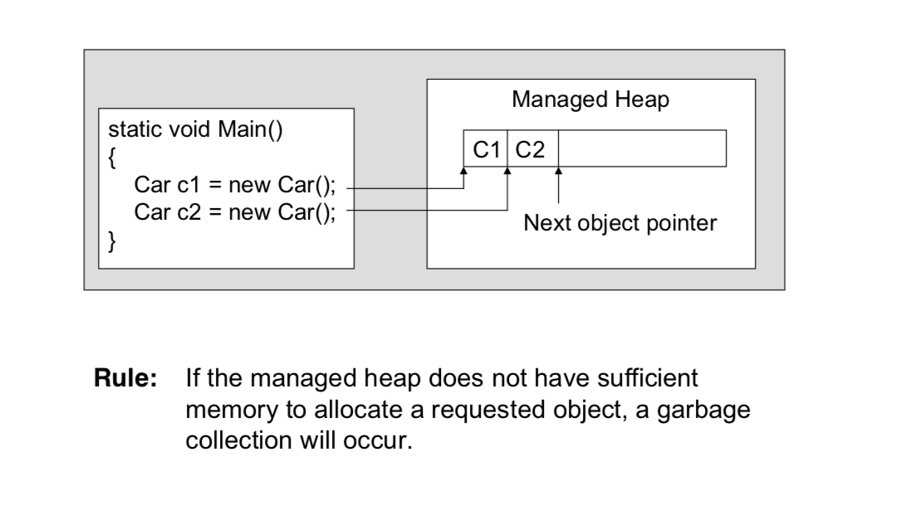

Slide 26
Garbage collection steps
The garbage collector searches for managed objects that are referenced in managed code (mark)
The garbage collector attempts to finalize objects that are unreachable (Sweep)
The garbage collector frees objects that are unmarked and reclaims their memory (Sweep)

Slide 27
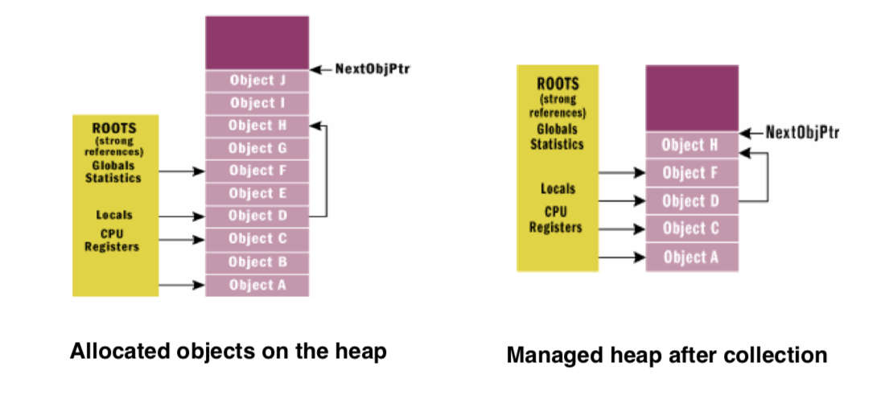
How to decide an object is unreachable
Object graph
represents each reachable object on the heap

Slide 28
Optimize the decision process
Object generations
Each object on the heap is assigned to a specific “generation” (0 ~ 2)
  Generation 1: newly allocated objects
  Generation 2: objects that survived a garbage collection
  Generation 3: objects that survived more than one garbage collection
The garbage collector first investigate generation 0 objects. If marking and sweeping these objects can result in required amount of free memory, any surviving objects’ generation are promoted by 1

Slide 29
The System.GC type
Provide a set of static method for interacting with garbage collection
Use this type when you are creating types that make use of unmanaged resource

Slide 30
Building finalizable objects
A call to Finalize () occurs:
natural garbage collection
GC.Collect()
Application domain is unloaded from the memory

Slide 31
Override System.Object.Finalize()
// Override System.Object.Finalize() via destructor syntax
class MyResourceWrapper
{
~MjyResourceWrapper()
{
// Clean up unmanaged resource here
}
}

Slide 32
Building Disposable Objects
Another approach to handle an object’s cleanup.
Implement the IDisposable interface
Object users should manually call Dispose() before allowing the object reference to drop out of scope
Structures and classes can both support IDisposal (unlike overriding Finalize())

Slide 33
Implementing IDisposable
public class MyResourceWrapper : IDisposable
{
// The object user should call this method // when they finished with the object.public void Dispose()
{
// Clean up unmanaged resources here.
// Dispose other contained disposable objects.
}
}
Rule:
Always call Disposal() on any object you directly create if the objects supports IDisposable.

Slide 34
Reusing the C# using Keyword
MyResourceWrapper rw = new MyResourceWrapper();
try {
// Use the member of rw
}
finally {
rw.Dispose()
}
Note: // Dispose() is called automatically when the // using scope exits.
using (MyResourceWrapper rw2 = new MyResourceWrapper())
{
// Use rw2 object.
}

Slide 35
Control Abstraction
Abstraction : Abstraction in programming languages
  "To Abstract" means simply to hide something.
  Every scientific discipline describes a certain phenomenon, concentrating only on aspects which have been found to be the most relevant.
  Programming languages are abstractions of the physical machine.

Slide 36
Two Classes of abstraction Mechanisms
Control abstraction : provides the programmer the ability to hide procedural data.
Data abstraction: allows the definition and use of data types without referring to how such types are implemented.

Slide 37
Control Abstraction
If a language supports control abstraction, this means that we can define our own control flow constructs. While this can certainly be abused and make a program totally incomprehensible, it can also make a program much clearer.
Preconditions for control abstraction are higher order functions, closures, and lambdas, although many abstractions are inconvenient without first-class continuations. Note that objects are in some ways equivalent to closures, so you can use some aspects of control flow abstraction in non-functional languages as well – though typically with more confusing syntax.

Slide 38
Control Abstraction
As an example, let's consider a using block in C# . Here, the languages implemented special syntax to represent this control flow:
  a resource is acquired
  a block is executed
  when control leaves the block, the resource is closed.
But with higher order functions, we could have implemented this our self!

Slide 39
Static void using<T>(T resource, Action<T> body)
Where T: IDisposable {
Try {
body {resource};
}
Finally
{
If(resource !=null)
resource.close();
}
}
This could then be used like:
Using(new File("foo.txt"), file => { …..});

Slide 40
Control Abstraction
So control abstractions let us evolve the language with user-defined control constructs, just like data abstraction lets us create user-defined data structures.
There are few notable uses of control abstraction:
  Promises
  Embedded DSLs
  Monads and functions

Slide 41
Composite Types
A composite data type is something you can divide into multiple other types. A box that contains more boxes, if you will. If a box is empty, then it's an elementary datatype. A box that contains another box is a composite type, because you can separate it into smaller types.

Slide 42
Error Handling
The goal of error handling (also known as exception handling) is quite simple: to prevent exceptions or errors thrown during the execution of an application request from reaching users. Ideally, users should not know that an exception occurred, or they should at least be provided with an informative message that tells them what they can do to resolve the problem.

Slide 43
        try
        {
        // Statement which can cause an exception.
        }
        catch(Type x)
        {
        // Statements for handling the exception
        }
        finally
        {
        //Any cleanup code
        }

Slide 44
Outline
We are going cover core concepts of OOP
  Class
    Constructor
    Multiple constructor
    Using, destructor
  Static: class, member, function
  Passing reference parameter in function.
  Generic
  Object

Slide 45
Outline
We are going cover core concepts of OOP
  Inheritance
    Relationship type IS-A
    Relationship type HAS-A (Modular Approach)
    Extend with Extension methods
  Encapsulation
    Getter/Setter
    C# getter setter
  Polymorphism
    Access Modifiers
    Modifiers
Strategy Design Pattern (modify HAS-A relationship)

Slide 46
Outline
Why?
Story
History
Object Oriented Programming(OOP)
46
I will try give real life examples so that you can remember.
Class
Object
Inheritance
Encapsulation
Polymorphism

Slide 47
Class
Why do we even need class?
Custom data-structure or custom data-type
More than one value, however struct is another option
int i = 500
Organize your code

Slide 48
Class
The concept of Class came from biology.
Purpose of the Class is to organize code.
Class itself is an abstract representation of an object like blue print.
In simple words a Class is a collection of methods/functions with properties or attributes of an object .
Data
Logic
Attributes or Properties
Methods or Behaviors

Slide 49
UML : Unified Modeling Language
Properties
Methods or behavior or functions

Slide 50

Class
{
Person
Attributes
FirstName: String
LastName: String
DateOfBirth: DateTime
Address: String
Gender: bool
Data
Properties
}
Walk():void
Talk() :void
Eat():void
Methods or Functions
Behavior
Logic

Slide 51
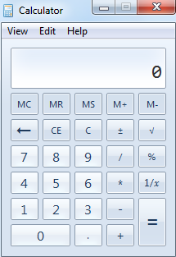
Class
Calculator
BasicCalculation
ScientificCalculation
ProgrammingCalculation

Slide 52

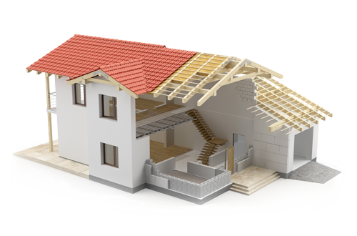
Object
Class Person {
  ...
  ...
  ...
}
Object
Class
Person person = new Person();
class
object

Slide 53
Object
You can get an object from an class after instantiation or creation of that class.
class Person {
  ...
  ...
  ...
}
Person person = new Person();
Person
Creation of a object from person class
person.FirstName = “Alice”;
person.LastName = “Romanson”;
String firstName = person.FirstName;
Sets value
Gets value

Slide 54
internal
class Person {
public Person() {
  ...
}
public string FirstName;
string LastName;
  ...
public void Walk() {
Console.WriteLine(FirstName + " is walking.");
}
  ...
}
Person person = new Person();
Person
given
private
Member of the class

Slide 55
given
public class Person {
public Person() {
  ...
}
public string FirstName;
string LastName;
  ...
public void Walk() {
Console.WriteLine(FirstName + " is walking.");
}
  ...
}
Person person = new Person();
Person

Slide 56
Class Constructor
The first method that is invoked when a class is created.
A class can have zero or multiple constructors (VS snippets “ctor”).

Slide 57
Class Destructor
A class can have zero or one destructor.
Usages to clean up memory.

Slide 58
Static Modifier
Access members without instantiating the class. Loads before everything shared across the application.

Slide 59
Static
class
All members must be static or else compilation error.
Can’t be inherited or created
Member
Public static members can be accessible by class name only from anywhere without instantiating the class.
Private static or only static members can only be accessible within the class from static functions only.
Can’t have any constructor or destructor.
a non-static member can call private static.
public static class ClassName {

Slide 60
Public static members can be accessible by class name only from anywhere without instantiating the class.
class ClassA {
//public static method
  public static void Print(string x){
  Console.WriteLine(x)
  }
//private non-static method
  void foo(){
  Console.WriteLine(“Called foo.”);
  }
}
  ClassA.Print(“Called foo.”); //call public static members by it’s class name without instantiating
class ClassB {
//constructor
  public ClassB (){
  }
  void Anything(){
  }
static void Anything(){
  }
}
  ClassA.Print(“Called foo.”); //call public static members by it’s class name without instantiating
  ClassA.Print(“Called foo.”); //call public static members by it’s class name without instantiating
  ClassA.Print(“Called foo.”); //call public static members by it’s class name without instantiating

Slide 61
Private static or only static members can only be accessible within the class from static functions only.
class ClassA {
//private method static method
  static void Print(string x){
  Console.WriteLine(x)
  }
//non-static method
  void foo(){
  Console.WriteLine(“Called foo.”);
  }
  static void foo(){
  Console.WriteLine(“Called foo.”);
  }
}
  ClassA.Print(“Called foo.”); //Possible
x
  this.Print(“Called foo.”); //calling a non-public static member is not possible from non static member.
x
  this.Print(“Called foo.”); //calling a non-public static member is not possible from non static member.
  ClassA.Print(“Called foo.”); //calling a static member is only possible inside class static member.
class ClassB {
//constructor
  public ClassB (){
  }
  void Anything(){
  }
static void Anything(){
  }
}
x
  ClassA.Print(“Called foo.”); //calling a non-public static member is not possible outside the class.
x
  ClassA.Print(“Called foo.”); //calling a non-public static member is not possible outside the class.
x
  ClassA.Print(“Called foo.”); //calling a non-public static member is not possible outside the class.

Slide 62
Passing reference Parameter
Passing data as reference and non reference in function.

Slide 63
String is a immutable type which means it is fixed type.
class ClassA {
static void main(string[] args) {
}
//non reference type method
  public static void Change(string x){
  x = “Changed”;
  }
//reference type method
  public static void ChangeRef(ref string x){
  x = “Changed”;
  }
}
string x = “Hello World”;
Console.WriteLine(x); // prints Hello World
Change(x);
Console.WriteLine(x); // prints Hello World
ChangeRef(ref x);
Console.WriteLine(x); // prints Changed
Console.ReadLine();
Hello World
Changed
Changed
RAM

Slide 64
class ClassA {
static void main(string[] args) {
}
//non reference type method
  public static void Change(int x){
  x = 13;
  }
//reference type method
  public static void ChangeRef(ref int x){
  x = 12;
  }
}
int x = 51;
Console.WriteLine(x); // prints 51
Change(x);
Console.WriteLine(x); // prints 51
ChangeRef(ref x);
Console.WriteLine(x); // prints 12
Console.ReadLine();
51
12
51
13
RAM

Slide 65
C# Class Pattern
[access modifier] [modifier] class[<Generic>] identifier {
  // [optional] zero or multiple constructors
  // [optional] data or field or properties or attributes
  // [optional] logic or behaviors or functions or methods
  // [optional] can have zero or one destructor
}
[access modifier] | Description | [modifier] | Description
public | No restriction | static | Can’t be created as well as inherited
internal or none | Only accessible from same project or assembly | sealed | Can’t be inherited
 |  | partial | Same class merge on compile time if within same namespace.
 |  | sealed partial | Can’t inherit + merge with same name class on compile time.

Slide 66
Class & Object Conclusion
Whenever you create a class you create a new type of data type like String or List object.

Slide 67
Inheritance
It is like getting something from the previous generation.
Person
Student
Teacher
FirstName: string
LastName: string
DateOfBirth: date
Address: string
Gender: bool
FirstName: string
LastName: string
DateOfBirth: date
Address: string
Gender: bool
CGPA: float
Completed Courses: byte
Joined Date: date
…
FirstName: string
LastName: string
DateOfBirth: date
Address: string
Gender: bool
SubjectProficiency: String
OfficeHours: string
Department : string
…
Walk():void
Talk() :void
Eat():boolean
Display():void
….
Display():void
….

Slide 68
Inheritance
It is like getting something from the previous generation.
Same
Same
Person
Student
Teacher
FirstName: string
LastName: string
DateOfBirth: date
Address: string
Gender: bool
FirstName: string
LastName: string
DateOfBirth: date
Address: string
Gender: bool
CGPA: float
Completed Courses: byte
Joined Date: date
…
FirstName: string
LastName: string
DateOfBirth: date
Address: string
Gender: bool
SubjectProficiency: String
OfficeHours: string
Department : string
…
Walk():void
Talk() :void
Eat():boolean
Display():void
….
Display():void
….

Slide 69
DRY
Don’t Repeat yourself.

Slide 70
Person
Student
Teacher
IS-A
Person
IS-A
Person

Slide 71
Inheritance
Inherit
It is like getting something from the previous generation.
Inherit
Derived Class
Parent Class
Child Class
Base Class
Sub Class
Super Class
Person
Student
Teacher
FirstName: string
LastName: string
DateOfBirth: date
Address: string
Gender: bool
FirstName: string
LastName: string
DateOfBirth: date
Address: string
Gender: bool
CGPA: float
Completed Courses: byte
Joined Date: date
…
FirstName: string
LastName: string
DateOfBirth: date
Address: string
Gender: bool
SubjectProficiency: String
OfficeHours: string
Department : string
…
Walk():void
Talk() :void
Eat():boolean
Display():void
….
Display():void
….

Slide 72
Inheritance
Class Person {
  ...
  ...
}
Class Student inherits from Person {
  ...
  ...
}
Class Teacher inherits from Person {
  ...
  ...
}
Person
Student
Teacher
Student student = new Student();
student.FirstName = “Alice”;
student.LastName = “Romanson”;

Slide 73
Inheritance
Class Person {
  ...
  ...
}
Class Student:Person {
  ...
  ...
}
Class Teacher:Person {
  ...
  ...
}
Person
Student
Teacher
Teacher teacher = new Teacher();
teacher.FirstName = “Alice”;
teacher.LastName = “Romanson”;

Slide 74
Inheritance
Class Person {
  ...
  ...
}
Class Student:Person {
  ...
  ...
}
Class Teacher:Person {
  ...
  ...
}
Student student = new Student();
student.FirstName = “Alice”;
student.LastName = “Romanson”;
Person
Student
Teacher
SuperClass type = new SubClass();
Person student1 = new Student();
Person teacher1 = new Teacher();
Type type ≠ new Different Type();
Teacher teacher2 ≠ new Student();
SubClass type ≠ new SuperClass();
Student student2 ≠ new Person();
Teacher teacher2 ≠ new Person();

Slide 75
Access Modifiers (MSDN)
public | No restriction
protected internal | Can be accessed from same assembly , however other assemblies can only be accessed within class if that class is derived from related class.
internal or no access modifier for class | Can be accessed from same assembly only.
protected | The type or member can be accessed only by code in the same class or struct, or in a class that is derived from that class.
private | The type or member can be accessed only by code in the same class or struct.
public
Internal or no modifier
protected
Protected internal
private

Slide 76

Inheritance
Sometimes you want to break things into more than one part.
Bike

Slide 77
Inheritance
Sometimes you want to break things into more than one part.
Bike inherits
Seat,handle,body,
tire,paddle,chain
Bike

Slide 78
Inheritance
Sometimes you want to break things into more than one part.
Bike inherits
Seat,handle,body,
tire,paddle,chain
chain
paddle
Tire
Body
Handle
Seat
Bike
Inherits chain
Inherits Paddle
Inherits Tire
Inherits Handle
Bike
Inherits Seat
Look for the interface implementation
Inherits Body

Slide 79
What is an interface?
An interface is like contracts that you must implement in your code.

Slide 80


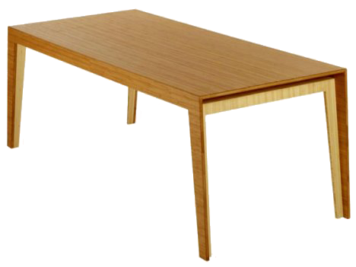
Encapsulation
Put Money Here
$11
$8
$5

Slide 81

Encapsulation
$11
$8
$5
Data Protection
Encapsulation
Data Hiding

Slide 82
Encapsulation
Class Person {
  private string firstName;
  ...
  ...
  // getter method for First Name attribute
  public string getFirstName() {
  return firstName;
  }
  // setter method for First Name attribute
  public void setFirstName(string name) {
  if(name != null){
  firstName = name;
  }
  }
}
}
getter
}
setter

Slide 83
Encapsulation
//C#
class Person {
  public string FirstName {get; set;}
}
  // getter method for First Name attribute
  public string getFirstName() {
  return firstName;
  }
  // setter method for First Name attribute
  public void setFirstName(string name) {
  firstName = name;
  }

Slide 84
Encapsulation
Class Person {
  private string firstName;
  public string FirstName {
    get{
    return firstName;
    }
    set{
    if(value != null){
    firstName = value;
    }
    }
  }
}
  // getter method for First Name attribute
  public string getFirstName() {
  return firstName;
  }
  // setter method for First Name attribute
  public void setFirstName(string name) {
  if(name != null){
  firstName = name;
  }
  }

Slide 85
Polymorphism
Simplicity: same thing in different kinds.
Inherit from a class from another or base class
Override a method from base class which has a virtual keyword on it.
Keep in mind access modifiers

Slide 86
Access Modifiers (MSDN)
public | No restriction
protected internal | Can be accessed from same assembly , however other assemblies can only be accessed within class if that class is derived from related class.
internal or no access modifier for class only | Can be accessed from same assembly only.
protected | The type or member can be accessed only by code in the same class or struct, or in a class that is derived from that class.
private | The type or member can be accessed only by code in the same class or struct.
public
Internal or no modifier
protected
Protected internal
private

Slide 87
Polymorphism
class Cat inherits Animal {
// override
  public override string Talk() {
  return “Meow”;
  }
}
Simplicity: same thing in different kinds.
Animal
----------------------
….
….
----------------------
Walk():void
Talk():void
Eat():void
class Animal {
... ...
public virtual void Talk(){
print(“generic animal talking”);
}
}
class Dog inherits Animal {
// override
  public override string Talk() {
  return “Woof”;
  }
}
Dog
-------------------….
-----------------
Talk():string
Cat
-------------------….
-----------------
Talk():string
Human
-------------------….
-----------------
Talk():string
print(dog.Talk());
print(cat.Talk());
print(human.Talk());
class Human inherits Animal {
// override
  public override string Talk() {
  return “Hello”;
  }
}

Slide 88
Polymorphism
Simplicity: same thing in different kinds.
Animal
----------------------
….
….
----------------------
Walk():void
Talk():void
Eat():void
class Animal {
... ...
public virtual void Talk(){
print(“generic animal talking”);
}
}
Dog
-------------------….
-----------------
Talk():string
Cat
-------------------….
-----------------
Talk():void
Human
-------------------….
-----------------
Talk():string
print(dog.Talk());
cat.Talk();
// display
// generic animal talking
print(human.Talk());

Slide 89
Modifiers (MSDN)
static | Declares a member that belongs to the type itself instead of to a specific object.
virtual | Declares a method or an accessor whose implementation can be changed by an overriding member in a derived class.
partial | Defines partial classes, structs and methods throughout the same assembly.
sealed | Specifies that a class cannot be inherited.
override | Provides a new implementation of a virtual member inherited from a base class.
http://msdn.microsoft.com/en-us/library/6tcf2h8w.aspx

Slide 90
Enforce Polymorphism
class Animal {
... ...
public void Talk(){
print(“generic animal talking”);
}
}
Abstract class or interface.
abstract class Animal {
... ...
public abstract void Talk(); // there must be no implementation
}

Slide 91
Abstract Class Vs. Interface
Abstract Class | Interface
Share common implemented code. (i.e. shares already implemented functions) | Only share contracts without implementation, in addition with public properties or fields.
Single Inheritance Support Only. | A class can inherit multiple interfaces.
Members can have different access modifiers. | Properties or members are all public.
May contain constructors, destructors, properties, functions or function contracts. | May only contain properties and function contracts.

Slide 92
What is AngularJS
AngularJS is a JavaScript framework that helps build web applications.
Created by Google.
AngularJS is a open source that means it can freely used and shared by anyone.
AngularJS is useful for building mainly SPA

Slide 93
What is SPA
SPA – Stands for Single page application that means a web application that interacts with the user by dynamically rewriting the current page rather than loading entire new pages from a server.

Slide 94
Benefits of AngularJS
Dependency injection
Two way data binding
Testing
ModelViewController
Directives, Filters etc

Slide 95
What is Angular CLI and Advantages
Angular CLI is command line tool that helps us in
  Create angular applications faster and with freat consistency
  Create the boiler plate code for angular features like classes, interfaces, enums etc
  It follows angular best practices and conventions out of the box
  Run unti and end-to-end tests
  Create optimized builds for deployment to production

Slide 96
Introduction to Automation Testing

Slide 97

What is an Automation Tool
A software to help us in
  Tests Execution
  Tests Verification
  Tests Reporting

Slide 98

Why we need Automation Testing
Saves Time and Money
Increases Correctness
Version changes
Increase Test Coverage
Increases speed, Efficiency Quality and Decreases cost
Helpful in Testing Complex Web Application

Slide 99
Automated Testing Process

Slide 100
Following steps are followed in the Automation process
Test Tool Selection
Define scope of automation
Planning, Design and Development
Test Execution
Maintenance

Slide 101

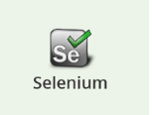
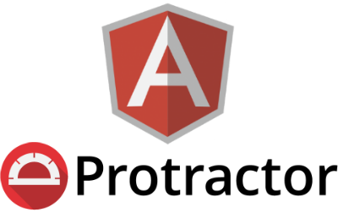
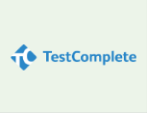



Test Tool Selection

Slide 102
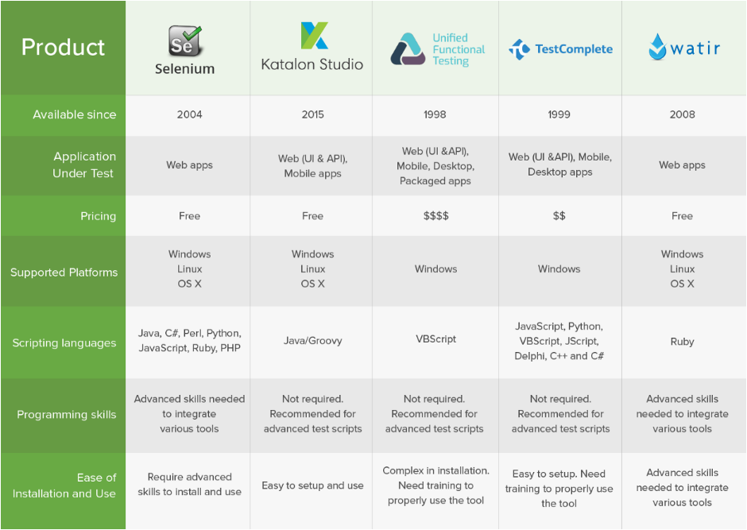
Test Tool Selection
Steps to follow
1 – Collecting requirements
2 – Categorize your requirements
  BASIC
  TECHNICAL
  BUSINESS
  FEATURES
3 – Create tool list against Basic Requirement
4 - Shortlist tools
5 – Create chart for comparison and score card

Slide 103
Define scope of automation
The scope of automation is the area of your Application Under Test which will be automated. Following points help determine scope:
  The features that are important for the business
  Scenarios which have a large amount of data
  Common functionalities across applications
  Technical feasibility
  The extent to which business components are reused
  The complexity of test cases
  Ability to use the same test cases for cross-browser testing

Slide 104
Planning, Design and Development
During this phase, you create Automation strategy & plan, which contains following details-
Automation tools selected
Framework design and its features
In-Scope and Out-of-scope items of automation
Automation testbed preparation
Schedule and Timeline of scripting and execution
Deliverables of Automation Testing

Slide 105
Test Execution
Automation Scripts are executed during this phase. The scripts need input test data before there are set to run. Once executed they provide detailed test reports.
Execution can be performed using the automation tool directly or through the Test Management tool which will invoke the automation tool.
Example: Quality center is the Test Management tool which in turn it will invoke QTP for execution of automation scripts. Scripts can be executed in a single machine or a group of machines. The execution can be done during the night, to save time.

Slide 106
Maintenance
As new functionalities are added to the System Under Test with successive cycles, Automation Scripts need to be added, reviewed and maintained for each release cycle. Maintenance becomes necessary to improve the effectiveness of Automation Scripts.

Slide 107


Slide 108


